Slide 1
Message Queing Telemetary Transport
Muhammad Moaz Amin Luis David Cabezas
Dawar Zaman

Slide 2


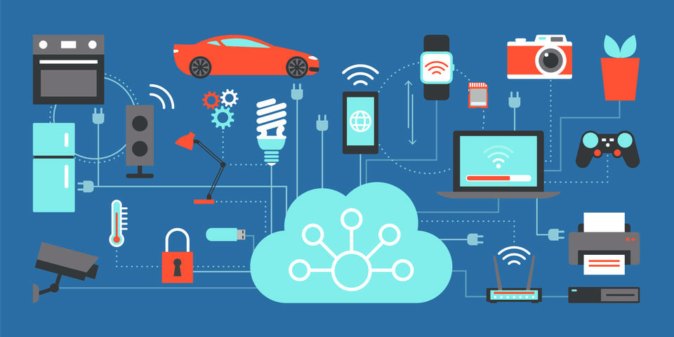

MOTIVATION
Billions of devices…..
The idea of an Internet of Things carries with it a central problem:
How are these of devices - with different performance capability, some mobile and some stationary, often connected over unreliable lines and with high latency times - communicate with each other so reliably and efficiently?
Simply HOW….?

Slide 3
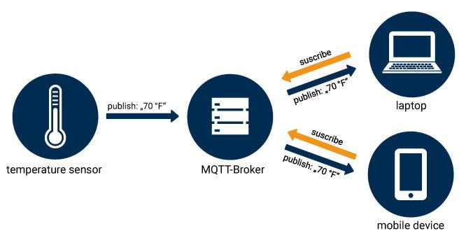
WHAT IS MQTT?
Communication between devices and other internet services is possible due to the presence of various communication protocols
Message Queuing Telemetry Transport is an extremely simple and lightweight open messaging protocol.
Its main purpose is to collect process, describe and evaluate data.
MQTT minimizes network bandwidth and device resource requirements while attempting to ensure reliability and delivery.
MQTT allows bi-directional communication between interconnected devices.

Slide 4

Historical Background
MQTT was invented by Dr Andy Stanford- Clark of IBM and Arlen Nipper of Arcom (now Eurotech), in 1999.
MQTT is in the process of undergoing standardisation at OASIS
The protocol specification is openly published and royalty-free
TCP/IP port 1883 is reserved with IANA for MQTT
TCP/IP port 8883 is also reserved for MQTT over SSL/Web

Slide 5
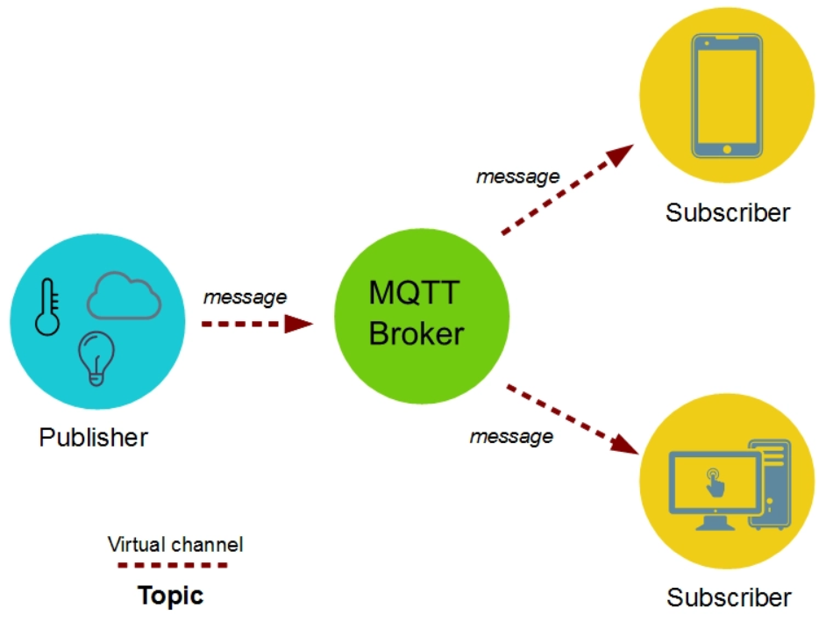
How MQTT works?
Basic principle works on the mechanism of publishing messages and subscribing.
Main entities involved are Client and Broker.
Client comprises of
Publisher = it sends the message
Subscriber = it receives the message from the broker
Broker is the one which is central. It takes data from publisher and sends to the Subscriber.

Slide 6
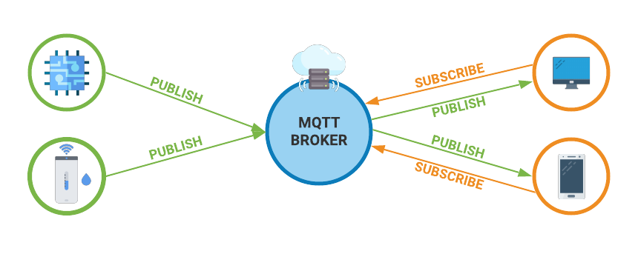
Levels of MQTT
The agreement between the sender of the message and the receiver of a message which defines the deliverance guarantee for a specific message is Quality of Service(QoS).
QoS 0
QoS 1
QoS 2
Two sides of message delivery
Publishing client to the broker.
Broker to the subscribing client.

Slide 7

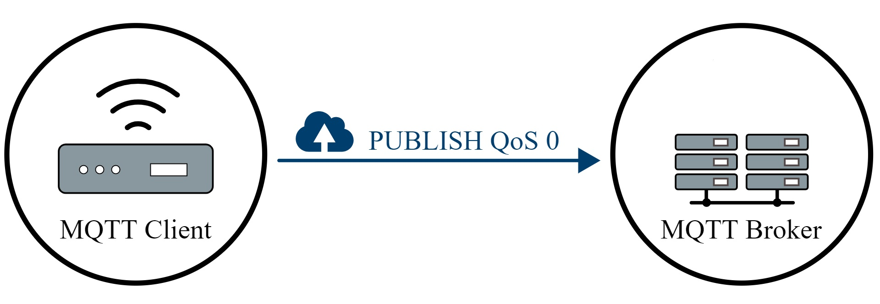
QoS 0

Slide 8
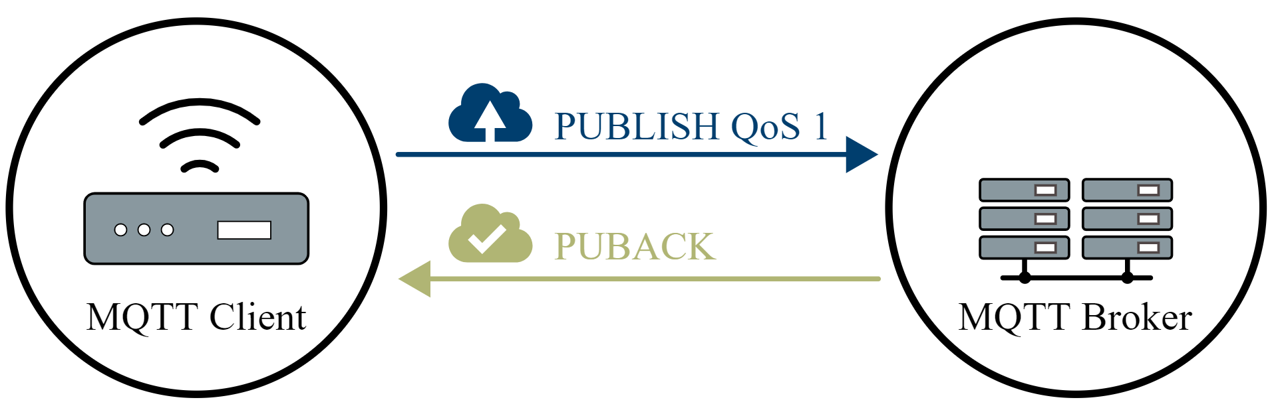
QoS 1

Slide 9
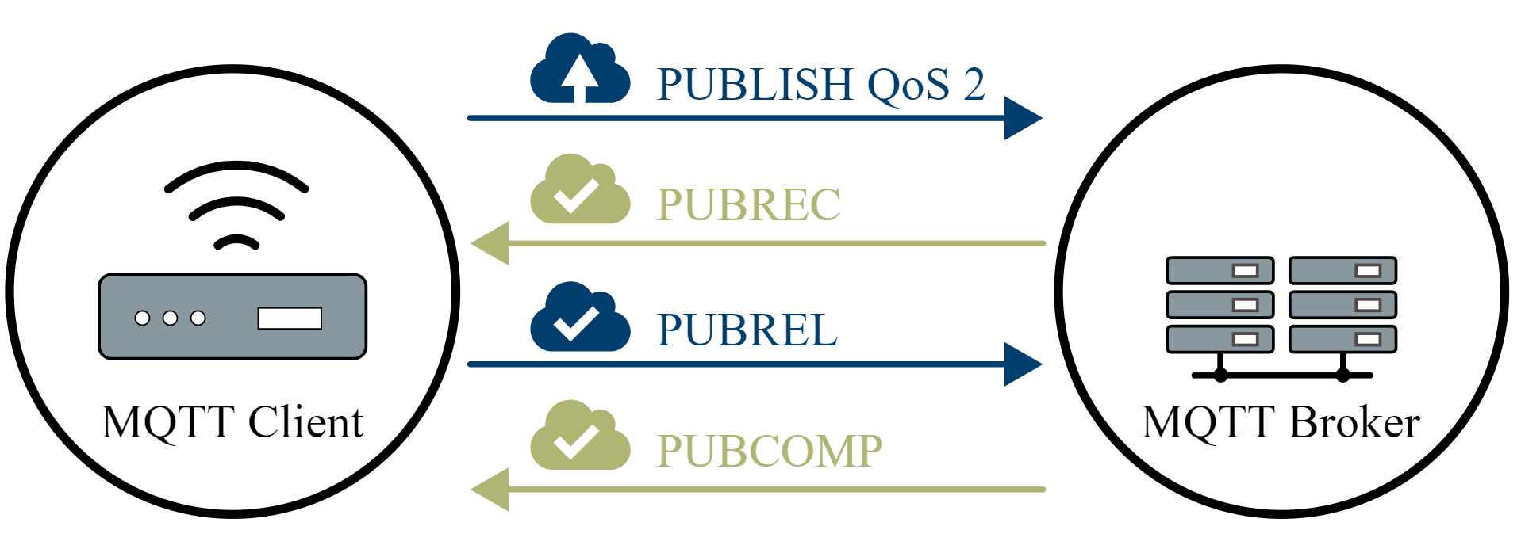
QoS 2

Slide 10
Applicability Over Various Protocol(s) / Supported Network Protocol(s)
For general communication TCP/IP is used and for secured communication SSL/TLS is used.
In a TCP/IP setting the client initiates the connection with the broker whereas in a SSL/TLS setting both the client and the broker send and receive certificates from each other and unless these certificates are validated from each side the connection does not take place.
SSL/TLS is not a lightweight encryption protocol therefore using it with MQTT completely defeats the purpose of using MQTT in the first place.

Slide 11
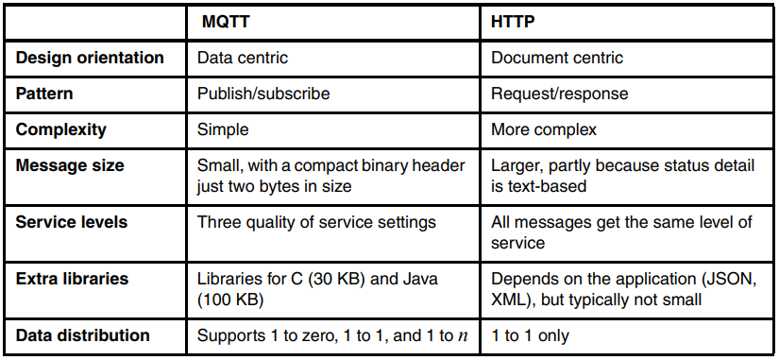
MQTT vs HTTP
What is HTTP?
The HTTP protocol uses a request/response model, which is currently the most common message exchange protocol. MQTT uses a publish/subscribe pattern.

Slide 12
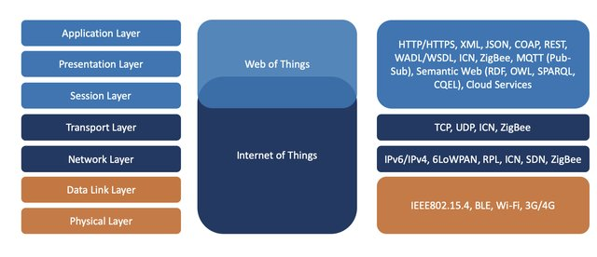
WEB OF THINGS ARCHITECTURE
Web of things is an expansion to the existing Internet of Things Architecture

Slide 13
Similar Commonly used Protocol(s)
Constrained Application Protocol (CoAP).
Advanced Message Queuing Protocol (AMQP).
Simple/Streaming Text Oriented Messaging Protocol (STOMP).
Simple Media Control Protocol (SMCP).
SSI (Simple Sensor Interface).
Data Distribution Service (DDS).

Slide 14
Conclusion
MQTT is a well-suited protocol for IoT related applications.
In terms of a big picture MQTT is adapting and advancing as the world of IoT is advancing and expanding so it will bring change on all levels.
Web of Things Architecture is an expanded version of IoT, and it also supports MQTT.
Newer MQTT versions (i.e., MQTT 5) have greatly improved than the previous versions.

Slide 15
THANK YOU

